Slide 1
LA’s BEST @USC
Genetics and Genetic Association Studies
David Conti, Ph.D.

Slide 2
Outline
Genetic Epidemiology
Allele Frequency Estimation
Linkage and linkage disequilibrium
Genome-wide association studies (GWAS)
Challenges with GWAS

Slide 3
Genetic Epidemiology

Slide 4
Types of Studies in Genetic Epidemiology
Migrant studies (ecological studies)
Familial aggregation
Segregation analysis
Linkage analysis
Association

Slide 5
Migrant Studies
Compare people who migrate from one country to another country with people in the two countries.
Examine migrant’s disease frequency:
If it does NOT change: suggests genetic components.
If it does change: suggests environmental components.
Problems with this?

Slide 6
Familial Aggregation
Demonstrate that diseases tends to run in families more often than would be expected by chance (without having any specific genetic model in mind). Includes twin studies.
Different approaches:
Common disease or continuous trait: enroll a random series of families and look at the pattern of correlations in the outcome between different types of relatives (e.g. sibling-sibling, parent-offspring, etc.)
Rare dichotomous outcome: identify probands (preferably in some population-based fashion) together with a comparable control series form the same population. Generate a pedigree
Case-control: compare the family history between cases versus controls.
Cohort: view the family members of the cases and controls as the two cohorts, one exposed to a case, the other not exposed.

Slide 7
Segregation Analysis
Determine if the pattern of disease among relatives is compatible with a single major gene, polygenes, or simply shared environment.
Segregation analysis is the process of fitting formal genetic models to data on disease phenotypes of family members.
If there is a single gene, can estimate dominance, penetrance and allele frequency.
Need pedigrees assembled in a systematic fashion to avoid bias.

Slide 8
Linkage Analysis
Requires blood samples obtained from potentially informative members of multiple case families.
Extract DNA and measure genetic markers at known locations.
Determine the general chromosomal location of disease susceptibility gene(s) by studying the co-segregation of markers and disease.
Recombination allows one to identify the approximate chromosomal location of a disease gene as:
No linkage between genes on different chromosomes since they segregate independently.
The probability of recombination between two loci on the same chromosome increases with the physical distance between them. Eventually this reaches ½ - the same as for two chromosomes.
If a genetic maker appears to co-segregate with disease, it will have a low recombination fraction.
Resolution is usually no more than a million base pairs.

Slide 9
Association Analysis
Test the association of the genotypes at a loci to an outcome:
Dichotomous: compare genotype frequencies between cases and controls.
Continuous: is the outcome associated with the genotype.
Estimated association could be:
Causal
Confounding by a nearby variant due to linkage disequilibrium
Confounding due to population structure.
No real need for family data.
Care must be taken in choice of control to avoid confounding due to population structure – although it is often possible to adjust for the confounding.
Includes genome-wide association studies.

Slide 10
Characterizing genetic variation

Slide 11
Genetic variation
Variation reflects differences in DNA among individuals/populations
Introduced through mutation and recombination
Sources of mutation (mutagenesis):
Spontaneous, errors during replication, errors during repair, etc.
Common mutation types
Single-nucleotide polymorphism (SNP; pronounced “snip”)
Small insertions or deletions (indel)
Large gene duplications, translocations, inversions, etc

Slide 12
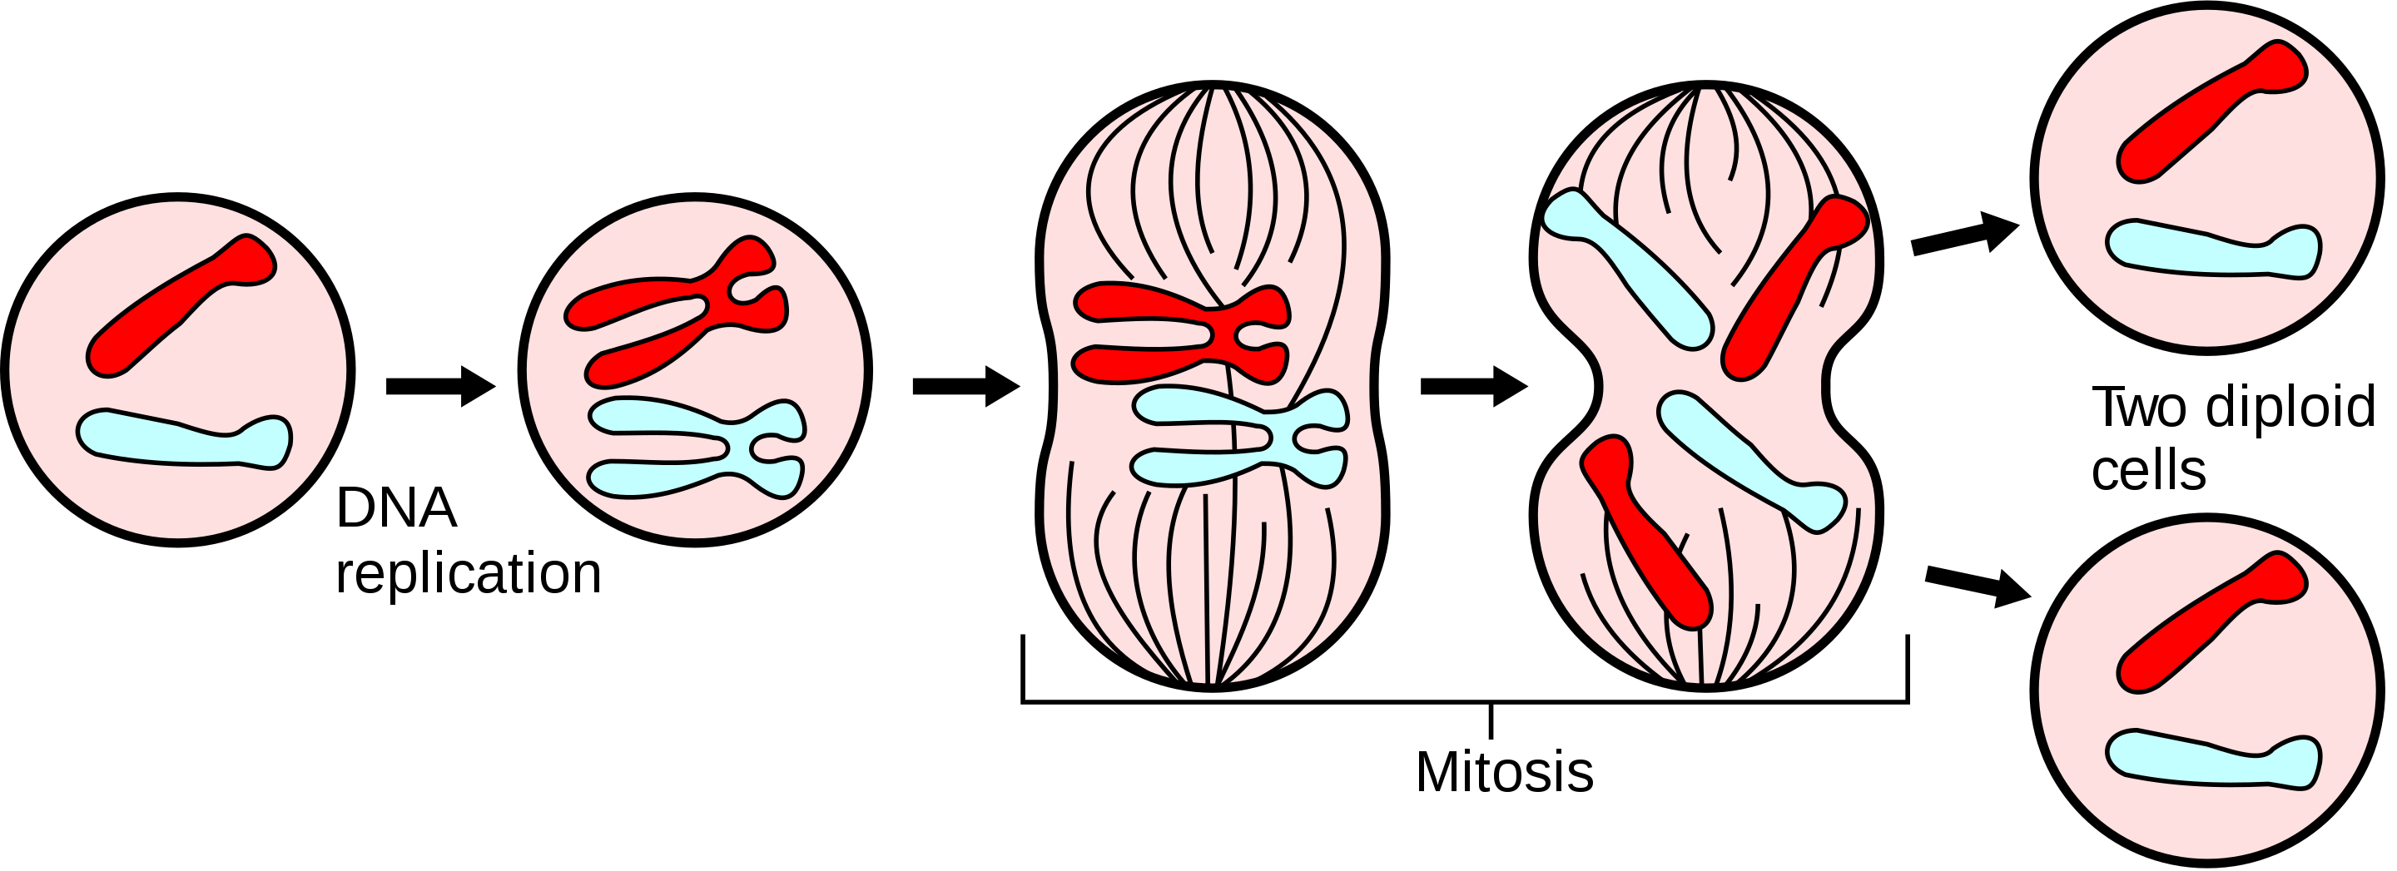
DNA replicates through mitosis and meiosis
DNA replication -> cell division
Does not contribute to genetic variation in a population
Start with
Pair of chromosomes
https://en.wikipedia.org/wiki/Mitosis

Slide 13
DNA replicates through mitosis and meiosis
DNA replication -> recombination -> cell division x2
Does contribute to genetic variation in a population
Start with
Two pair of chromosomes (short and long)
https://en.wikipedia.org/wiki/Meiosis

Slide 14
Some definitions
Locus (plural loci) refers to a genomic region
Bit ambiguous -> entire gene? Single variant?
Allele refers to a particular variant at a locus
E.g., ‘G>C’ mutation where ‘X>Y’ means ‘Y’ replaced ‘X’ by mutation
Allele frequency refers to the freq/prob of observing allele in a population
Genotype refers to genetic information in an individual
E.g., AA, Aa, aa for some alleles A, a -> recode as 0, 1, 2
Genotype frequency refers to the freq/prob of observing genotype in a population

Slide 15
Allele frequency estimation
Allele frequencies are used in population genetics to study structure, dynamics, and evolution
Forms the building blocks of genetics
Population, quantitative, and statistical
Given random individuals, can use allele counting to determine frequency
Related individuals are more complicated and can lead to loss of information
Example
N | Allele | A₁A₁ | A₁A₂ | A₂A₂ | Total
Individuals |  | 30 | 60 | 10 | 100
Alleles | A₁ | 60 | 60 | 0 | 120
 | A₂ | 0 | 60 | 20 | 80
Pr(A₁) = ?
Pr(A₂) = ?

Slide 16
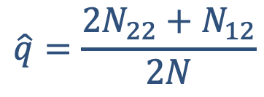
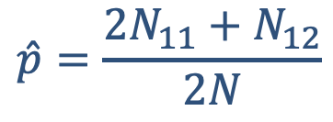
Allele frequency estimation
Let A₁, A₂ be two alleles at a bi-allelic locus with frequencies p, q
Let N₁₁, N₁₂, N₂₂ denote 1-1 homozygotes, heterozygotes, and 2-2 homozygotes, with N = N₁₁ + N₁₂ + N₂₂
How can we infer p, q?
N | Allele | A₁A₁ | A₁A₂ | A₂A₂ | Total
Individuals |  | 30 | 60 | 10 | 100
Alleles | A₁ | 60 | 60 | 0 | 120
 | A₂ | 0 | 60 | 20 | 80
$$\hat{p}=\frac{2N_{11}+N_{12}}{2N}$$
$$\hat{q}=\frac{2N_{22}+N_{12}}{2N}$$
p = 120/200=60%
q = 80/200=40%

Slide 17
Hardy Weinberg Equilibrium (HWE)
Assume a population with
No inbreeding
Is not under selection
No difference in allele frequencies between sexes
Mates randomly
How can we model alleles being sampled in a (large) population?
Sample with replacement -> binomial sampling!
Pr(A₁A₁) = p²
Pr(A₁A₂) = 2pq
Pr(A₂A₂) = q²

Slide 18

Binomial Sampling – Random Mating

Slide 19
Maximum Likelihood Estimate (MLE) for MAF under HWE
What?
Describe the probability of the observed data (i.e. the genotypes) as a function of the parameters (i.e. allele frequency) in a mathematical function/statistical model.

Slide 20
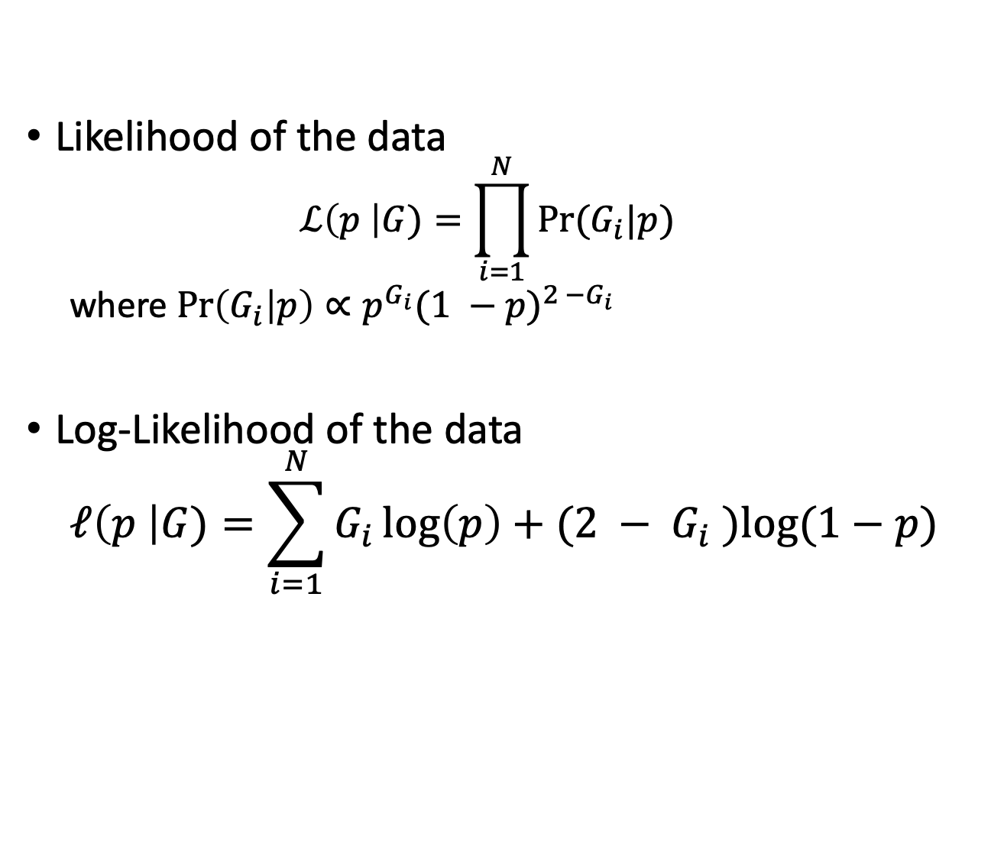
Maximum Likelihood Estimate for p under HWE
Likelihood of the data
$$ℒ\left(p \right|G)=\prod_{i=1}^{N}{Pr⁡(G_{i}|p)}$$
where $\operatorname{Pr}\left(G_{i} | p\right)∝p^{G_{i}}{(1 −p)}^{2 −G_{i}}$
Log-Likelihood of the data
$$ℓ\left(p \right|G)=\sum_{i=1}^{N}{G_{i}\log\left(p\right)+(2 − G_{i} )log⁡(1−p) }$$

Slide 21
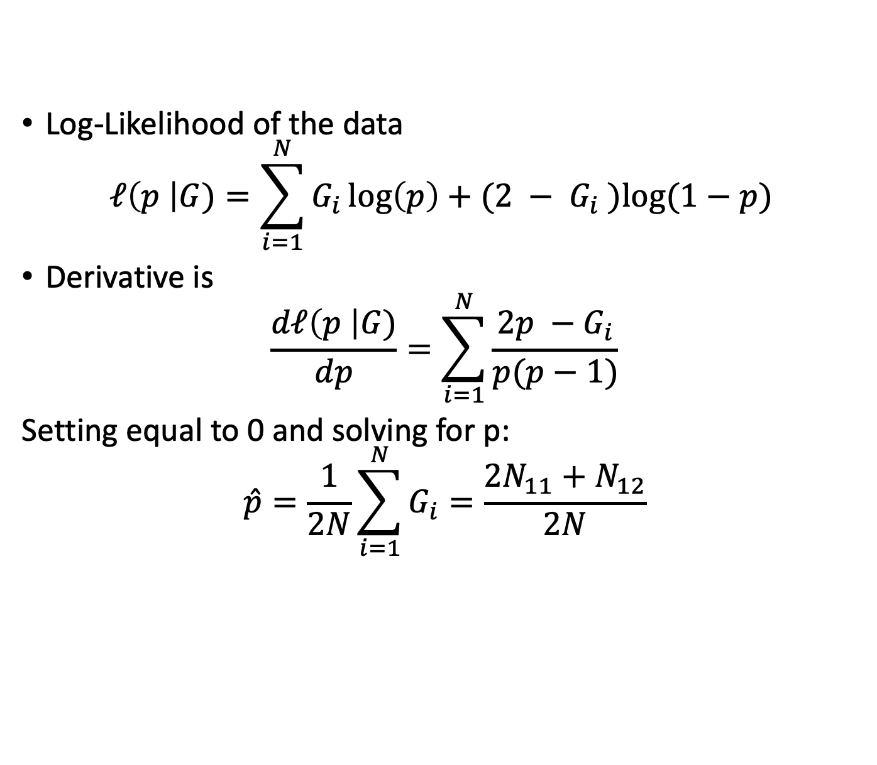
Maximum Likelihood Estimate for p under HWE
Log-Likelihood of the data
$$ℓ\left(p \right|G)=\sum_{i=1}^{N}{G_{i}\log\left(p\right)+(2 − G_{i} )log⁡(1−p) }$$
Derivative is
$$\frac{dℓ\left(p \right|G)}{dp}=\sum_{i=1}^{N}{\frac{2p −G_{i}}{p(p−1)}}$$
Setting equal to 0 and solving for p:
$$\hat{p}=\frac{1}{2N}\sum_{i=1}^{N}{G_{i}}=\frac{2N_{11}+N_{12}}{2N}$$

Slide 22
Linkage
And
Linkage Disequilibrium
Notes:
http://csg.sph.umich.edu/abecasis/class/666.03.pdf

Slide 23
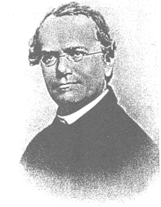
Mendel’s Laws of Inheritance
Mendel's 1st Law - The Law of Segregation
During gamete formation each member of the allelic pair separates from the other member to form the genetic constitution of the gamete
Mendel's 2nd Law - The Law of Independent Assortment
The segregation of the alleles of one allelic pair is independent of the segregation of the alleles of another allelic pair during gamete formation*
*If they are not close together on the same chromosome
Note: Mendel’s laws are probability models. Therefore, they are not always correct.

Slide 24
DNA replicates through mitosis and meiosis
DNA replication -> recombination -> cell division x2
Does contribute to genetic variation in a population
https://en.wikipedia.org/wiki/Meiosis

Slide 25
The Concept of Linkage
Genes close together on the same chromosome do not pass independently to the next generation
Therefore, genes close together violate Mendel’s 2nd Law and are called “linked” genes
However, they also do not always pass together due to recombination during meiosis
Recombination: an exchange of genetic material between chromosomes. This process is also called “crossing over”.

Slide 26
The Concept of Linkage
A
A
a
a
A
A
a
a
B
B
b
b
B
b
B
b
C
C
c
c
C
c
C
c

Slide 27
The Concept of Linkage
Final Gametes After Recombination
A
A
a
a
Non−recombinants
Non−recombinants
Recombinants
Recombinants
B
b
b
B
C
c
c
C

Slide 28
The Concept of Linkage
The further the physical distance between genes along a chromosome, the higher the probability a recombination event will occur between them
Recombination rate is higher in females compared to males
Recombination occurs roughly (VERY ROUGHLY) in proportion to chromosome length
The recombination fraction (θ) is the proportion of gametes that are recombinants or that undergo an odd number of cross−over events

Slide 29
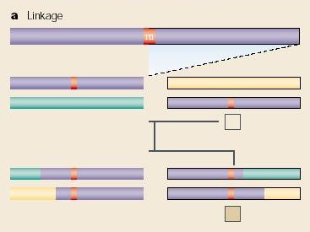
Linkage vs. Association
Difference between linkage and association analysis

Slide 30
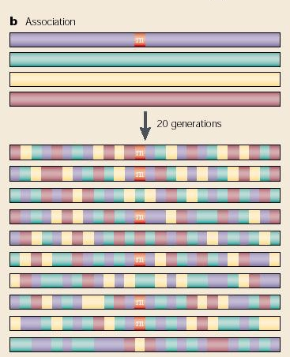
Linkage vs. Association
Difference between linkage and association analysis

Slide 31
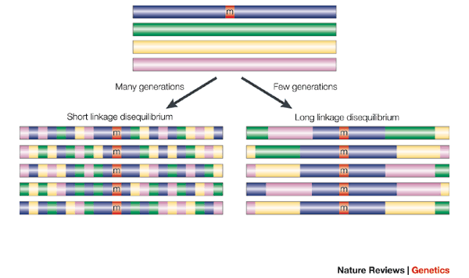
These blocks shrink over many generations due to repeated recombination

Slide 32
Linkage Disequilibrium
Both linkage and association analysis take advantage of the fact that there is linkage disequilibrium (LD) across the genome
Given the higher resolution of SNPs, LD among SNPs provides better information on the potential location of a critical variant
Several measures of LD
Likelihood ratio test
D and D′ (Lewontin, 1964)
R, aka Δ (Hill and Robertson, 1968)
Association testing with regression

Slide 33
Linkage Disequilibrium
Let’s assume 2 biallelic loci (A and B) with the following notation for the allele proportions
 | B | b
A | p_{AB} | p_{Ab} | P_{A}
a | p_{aB} | p_{ab} | P_{a}
 | P_{B} | P_{b}
Under linkage equilibrium (LE) for distal loci:
P_{AB} = p_{A} p_{B}
P_{Ab} = p_{A} p_{b} = p_{A} (1- p_{B})
P_{aB} = p_{a} p_{B} = (1- p_{A}) p_{B}
P_{ab} = p_{a} p_{b} = (1- p_{A}) (1- p_{B})

Slide 34
Linkage Disequilibrium
Basic component of most measures of LD is the disequilibrium coefficient (D), the difference between observed and expected number of haplotypes
D_{AB} = P_{AB} - p_{A} p_{B}
Given D_{AB}, then
P_{AB} = p_{A} p_{B} + D_{AB}
P_{Ab} = p_{A} p_{b} - D_{AB}
P_{aB} = p_{a} p_{B} - D_{AB}
P_{ab} = p_{a} p_{b} + D_{AB}

Slide 35
Linkage Disequilibrium
D is difficult to interpret
Sign of D_{AB} is arbitrary
Common convention: set A and B to be the common allele, a and b to be the rare allele
The range of D is dependent upon allele frequencies
Difficult to use D to compare different sets of markers

Slide 36
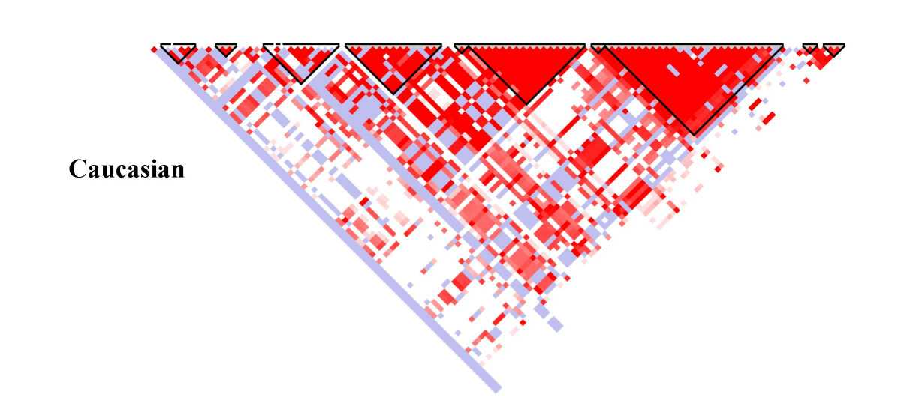
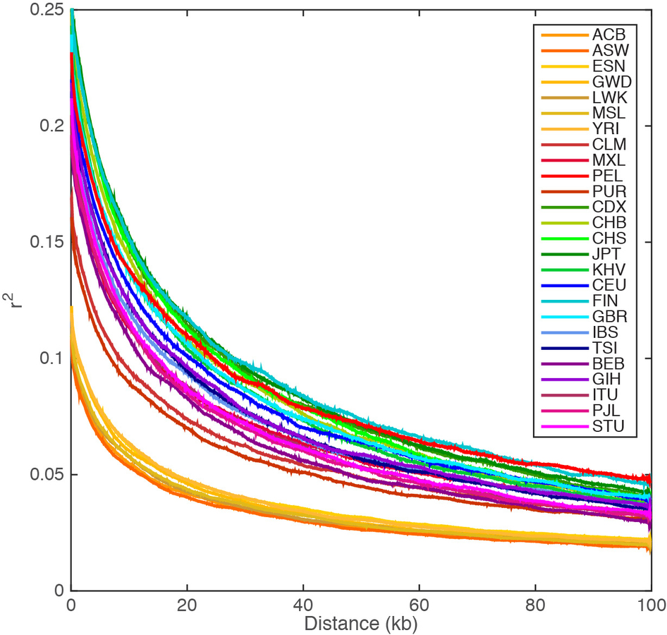
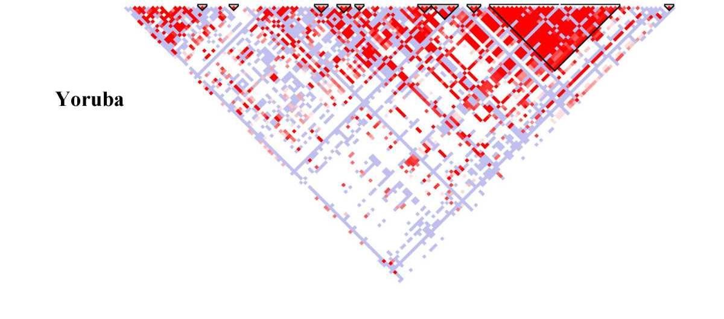
Some nearby variants are highly correlated
Recombination induces haplotype “blocks” of correlated SNPs
Linkage disequilibrium decays with distance
http://graphics.cs.wisc.edu/WP/vis10/archives/458-hapmap-linkage-disequilibrium-plot
A global reference for human genetic variation

Slide 37

Linkage

Slide 38
Disease Mapping via Association
Notes:
http://csg.sph.umich.edu/abecasis/class/666.03.pdf

Slide 39
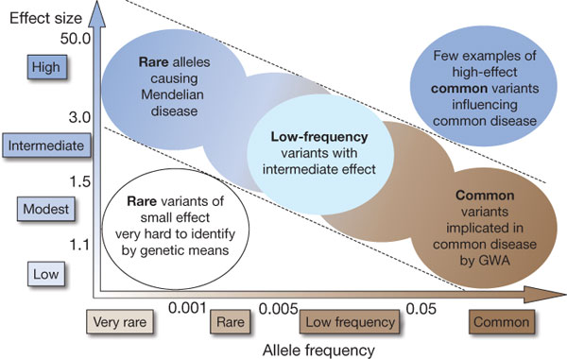
Linkage vs. Association
From Manolio et al. Nature 461:747−753, 2009

Slide 40


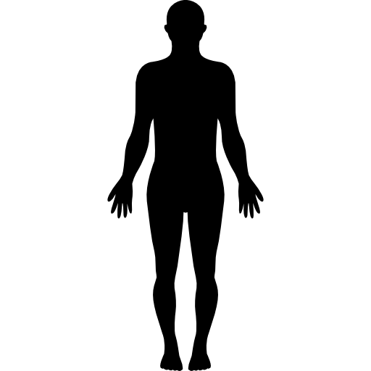

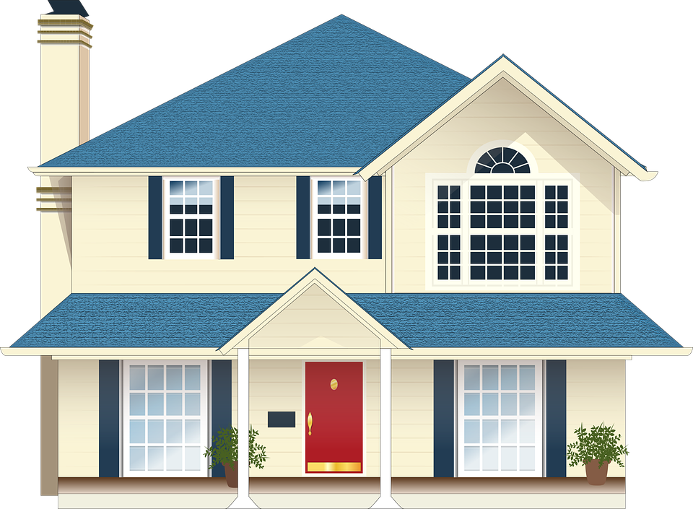


Phenotype = f(Genetics, Environment)
=
+
phenotype
genetic variations
environmental variations
Why do we study genetics?
Understand the biological mechanism of traits and diseases
Improve diagnosis of certain genetic disorders
Help develop personalized medicine

Slide 41
Disease mapping
Given a collection of individuals, it is a goal in medical genetics to map the genetic architecture of a disease: the genes responsible for a disease.
Knowing the genetic architecture of a disease enables:
Design of simple genetic tests for the disease.
Find druggable targets for therapeutic design.
Traits may be Mendelian (single gene), or complex (multi-gene)

Slide 42
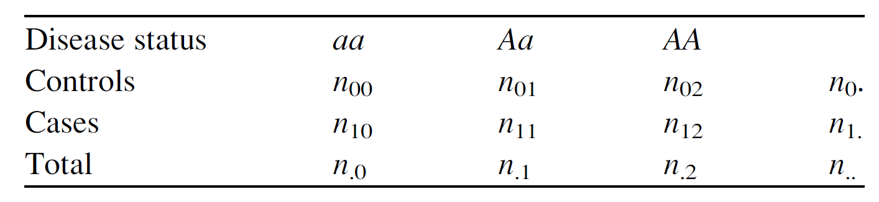
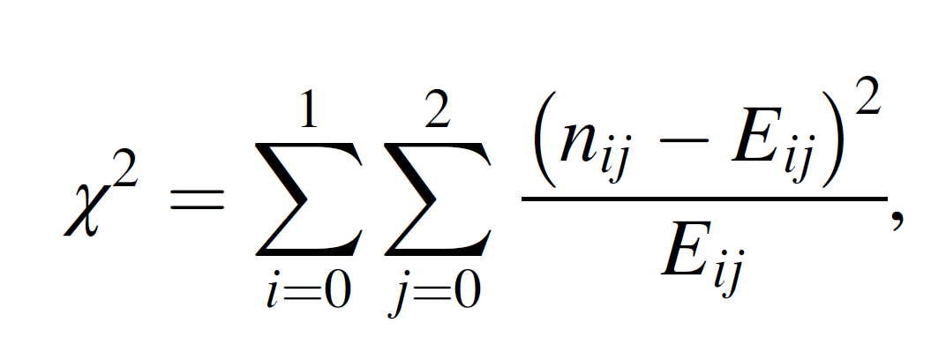
Testing a single gene/SNP for association
Case control design: Cases: individuals with a disease.
Controls: individuals without a disease.

Slide 43
Testing a single gene/SNP for association
Test with Chi-squared, two degrees of freedom.
Iterate over cases/control
Iterate over genotypes: 00, 01, 11

Slide 44
Testing a single gene/SNP for association
Test with Chi-squared, two degrees of freedom.
E_{ij} = genotype frequency * sample size
E₀₁ = (n_{0.} n_{.1})/n..
Iterate over cases/control
Iterate over genotypes: 00, 01, 11

Slide 45

Disease Mapping - Penetrance

Slide 46
Single gene association studies are problematic
It is possible to sequence a single SNP from a case/control study and test for significance.
There may be bias in selecting the candidate genes (e.g. previous studies that were not significant not considered), how to account for multiple-test correction?
Difficult to detect poor design in case/control studies for small effect variants.

Slide 47
Single gene association studies are problematic
It is possible to sequence a single SNP from a case/control study and test for significance.
There may be bias in selecting the candidate genes (e.g. previous studies that were not significant not considered), how to account for multiple-test correction?
Difficult to detect poor design in case/control studies for small effect variants.
Solution: unbiased genome-wide association studies: test all SNPs in a genome for association with a disease, and multiple-test correct according to number of SNPs.

Slide 48
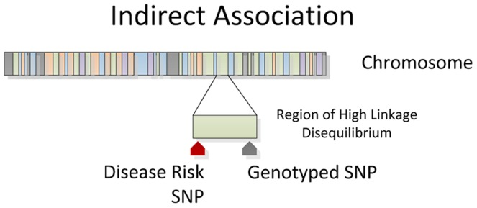
GWAS: Indirect Association
Chip-based microarray technology facilitated assaying one million or more SNPs.
Illumina and Affymetrix.
This allows for indirect association via linkage disequilibrium.
Bush WS, Moore JH.
PLoS Comput Biol. 2012;8:e1002822.

Slide 49
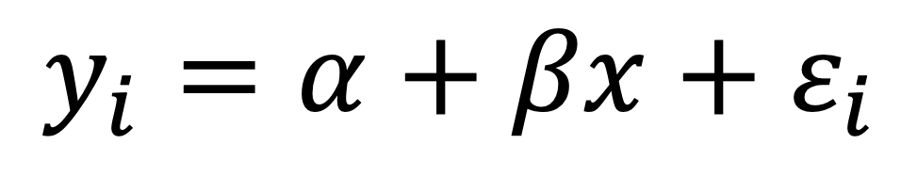
Associations between genotype and phenotype may be found using linear regression
$$y_{i}=α+βx+ε_{i}$$
Phenotype
Fixed effect not dependent on genotype; environment (e.g. age)
Effect * genotype
Noise

Slide 50
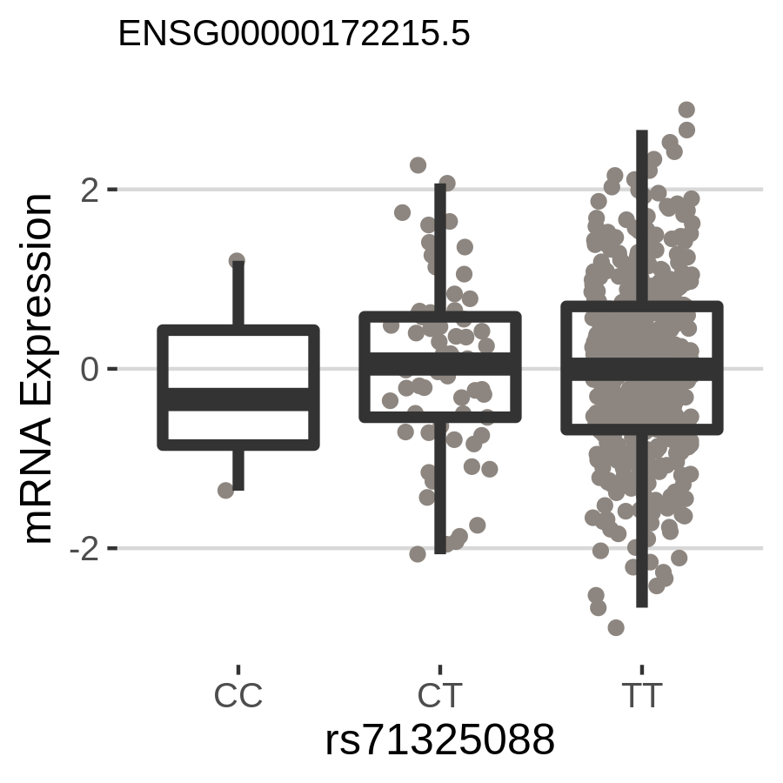
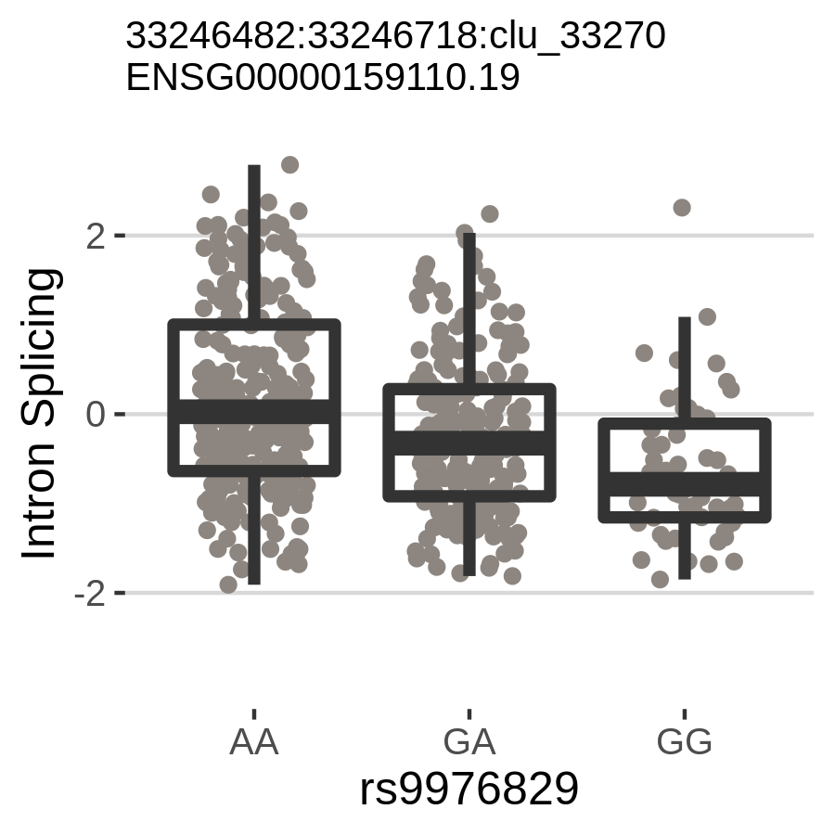
What is an “association”?
Let y be a quantitative phenotype measured in N individuals and let x be the genotype at a SNP
Does change in x track with change in y?
No!
Yes!
P = 0.93
P = 5.54e-11

Slide 51
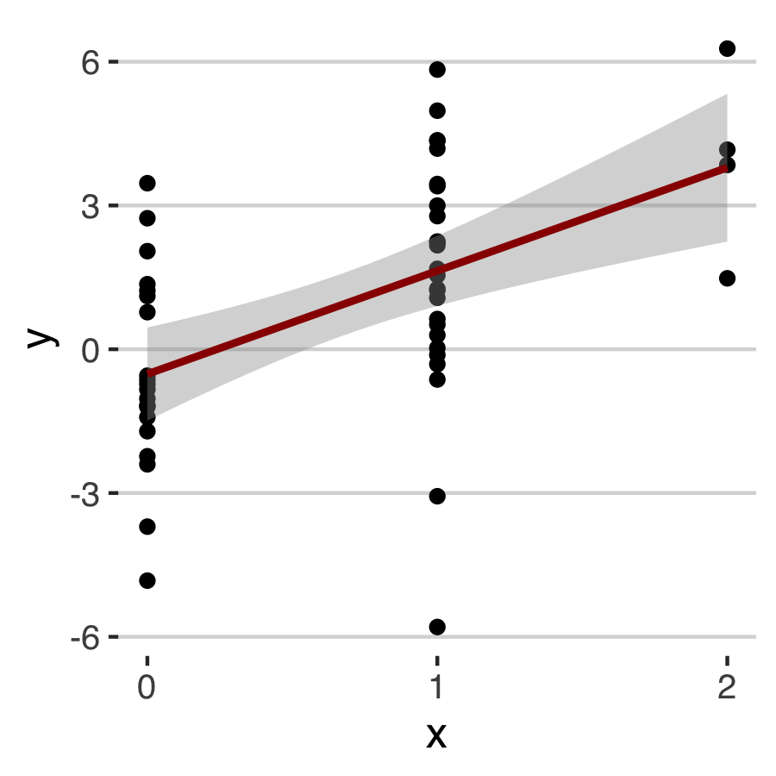
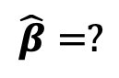
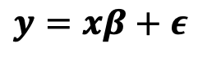
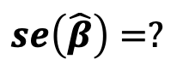
What is an “association”?
Let y be a quantitative phenotype measured in N individuals and let x be the genotype at a SNP
We can model the effect of x on y as β and “unexplained” signal as ε
Assume linear change in x -> y
$$y=xβ+ε$$
$$\hat{β}=?$$
$$se\left(\hat{β}\right)=?$$

Slide 52
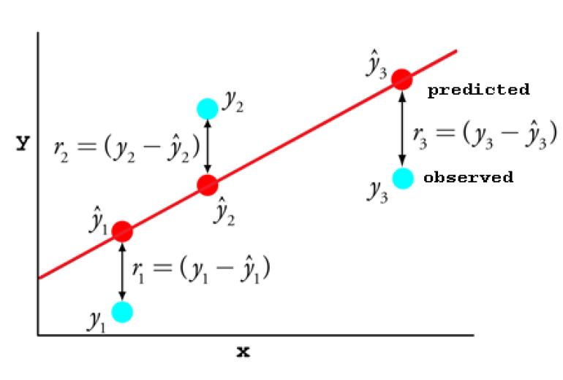
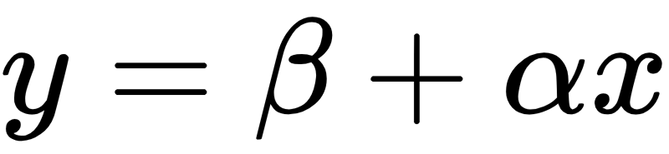
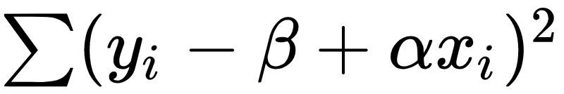
Fitting a linear regression
Given
And a series of (x_{i}, y_{i}) points:
Find 𝛽 and 𝛼 such that
is minimized.

Slide 53
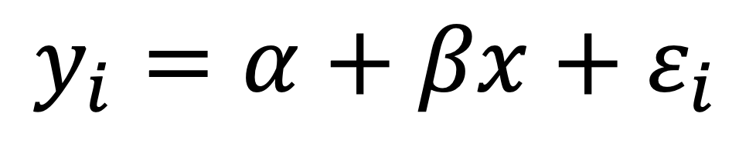
Evaluating Association of SNPs
$$y_{i}=α+βx+ε_{i}$$

Slide 54
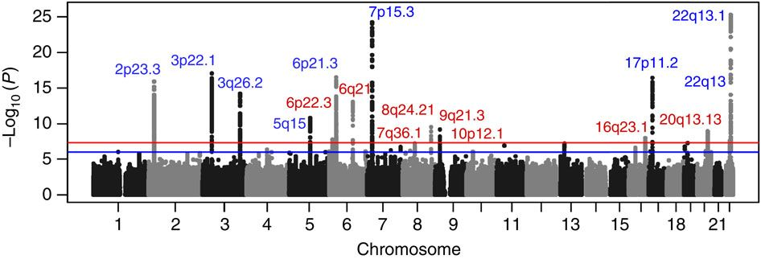
Results for GWAS are often summarized in a Manhattan plot
Each point is a SNP. Y values are p-value, and X chromosomal location.

Slide 55
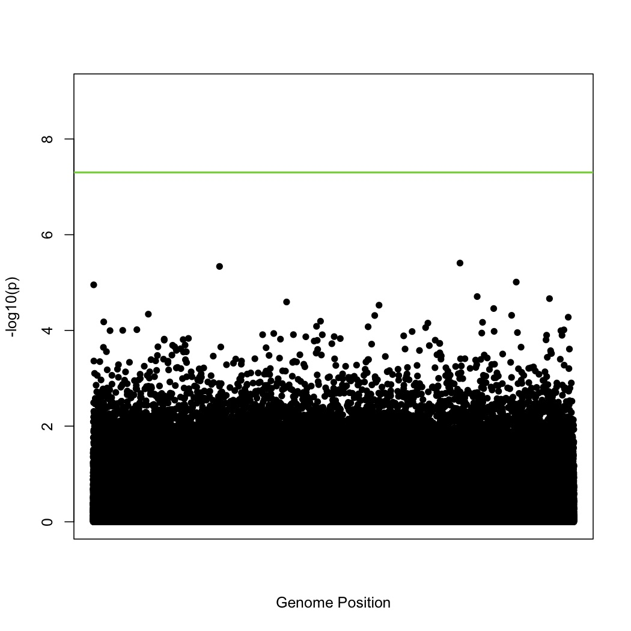
Typical GWAS
How do you determine genomewide significance?
Population specific?
Dudbridge F, Gusnanto A Genet Epidemiol. 2008;32:227–234.

Slide 56
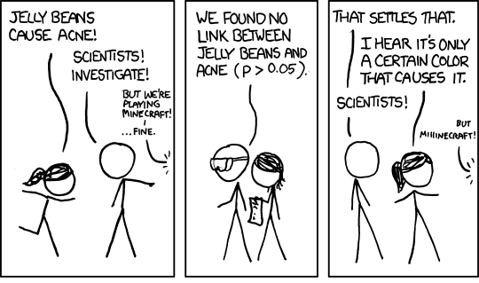
When is a result significant?
Commonly results are considered statistically significant if the probability of the result happening by chance is < 0.05.
What if multiple genes are tested for association?
xkcd.com

Slide 57
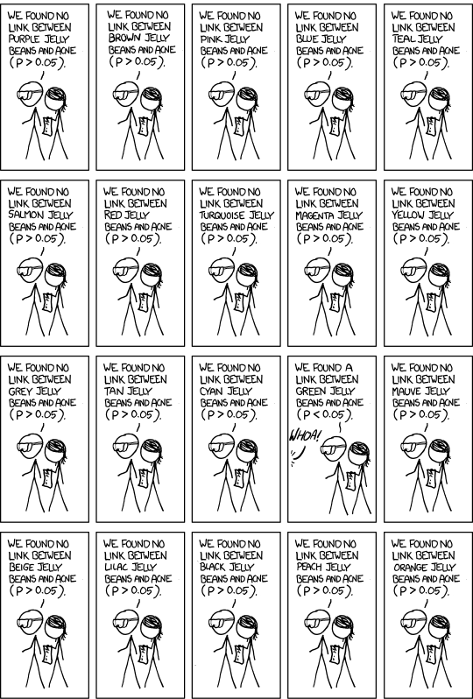
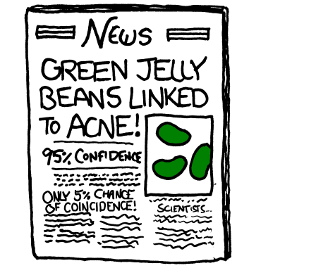

Slide 58
Multiple test correction
Given m tests, the Bonferroni correction controls false discovery rates by scaling the significance threshold ɑ (ɑ=0.05) by m, e.g.:
Reject any test p_{i} if p_{i} < ɑ/m

Slide 59
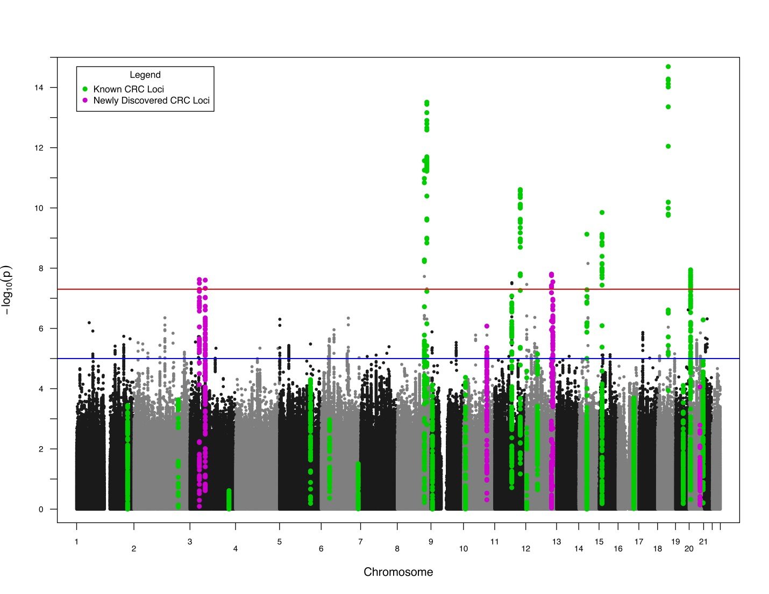
GWAS Results
Schumacher et al. 2015

Slide 60
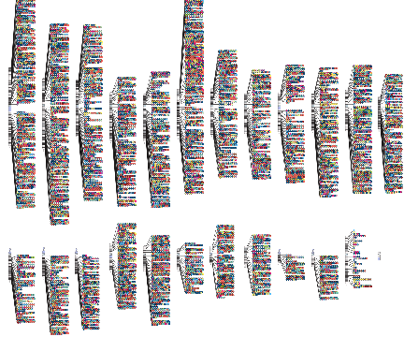
Genome-wide Association
GWAS Catalog: http://www.ebi.ac.uk/gwas
https://www.ebi.ac.uk/gwas/docs/diagram-downloads

Slide 61
Genetic Diversity in GWAS
Notes:
http://csg.sph.umich.edu/abecasis/class/666.03.pdf

Slide 62
GWAS Results
Schumacher et al. 2015

Slide 63
Association tests can be confounded by ancestry
Campbell et al. Nat Gen 2005
Campbell et al investigated height in European populations
Found association evidence at LCT
Differing allele frequencies across Europe
likely FP due to stratification

Slide 64
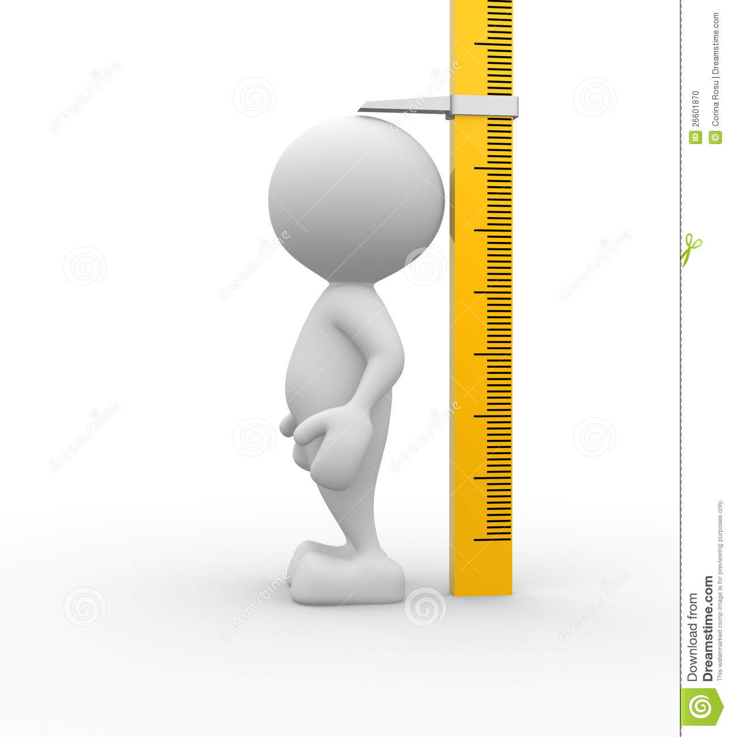

Potential Confounding
Within European Diversity (By Region? By Country? By Town?)
Population
Structure
Higher levels of Northern European ancestry
Increased Height
Allele Frequency
Differences
Notes:
* Reference for CHS

Slide 65
Relationships Among Individuals
High
Correlation
Low
Correlation
Cryptic
Stratification
Siblings
Unrelated
Individuals
Nuclear
Families
Ethnic
Similarity
65

Slide 66
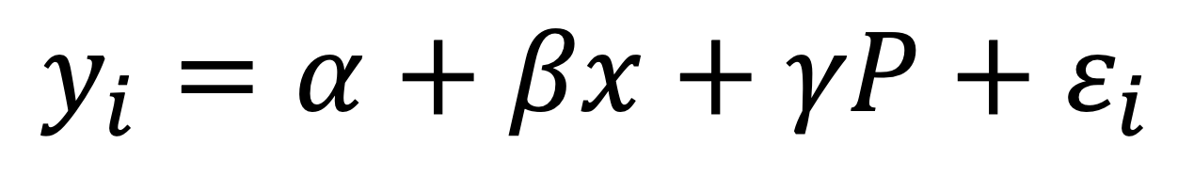
Analysis Strategies
$$y_{i}=α+βx+{γP+ε}_{i}$$
High
Correlation
Low
Correlation
Cryptic
Stratification
Siblings
(Pair
Intercept)
Unrelated
Individuals
Ethnic
Similarity
(Population)
Nuclear
Families
(Family, mating type, or
variance components)
66

Slide 67

Genetic Diversity

Slide 68
Identify Sub-Populations
Race, Ethnic, or Religious sub-divisions.
Parental or Grandparental Information.
Use set of M markers to identify the sub-population structure via clustering techniques.
Hierarchical clustering
K- means
Model-based clustering (Fraley and Raftery, 2002)
Bayesian approaches (Pritchard et al. 2000, 2001; Satten et al. 2001, Corander et al. 2003, 2004).
Principal Components (Cavalli-Sforza et al 1978, Patterson et al. 2006).

Slide 69
Using Principal Components
Utilize a genotype matrix of SNP (i) x Individuals (j).
Calculate principal components and eigenvectors.
The ancestry of individual j along the kth axis of variation equals coordinate j of the kth eigenvector.
The ancestry values can be either positive or negative and should not be interpreted as percentages.

Slide 71
Genetic Similarity

Slide 72
Hap Map 3 Populations
European Ancestry:
CEU: Northern and Western European ancestry from Utah
TSI: Toscani from Italy
Asian Ancestry:
CHB: Han Chinese from Beijing, China
CHD: Chinese from Denver, CO
JPT: Japanese from Tokyo, Japan
African Ancestry:
YRI: Yoruba from Ibanan, Nigeria
MKK: Maasai from Kinyawa, Kenya
LWK: Luhya from Webuye, Kenya
ASW: African ancestry from Southwest, USA
GIH: Gujarti Indians from Houston, TX
MEX: Mexican ancestry from Los Angeles, CA

Slide 73
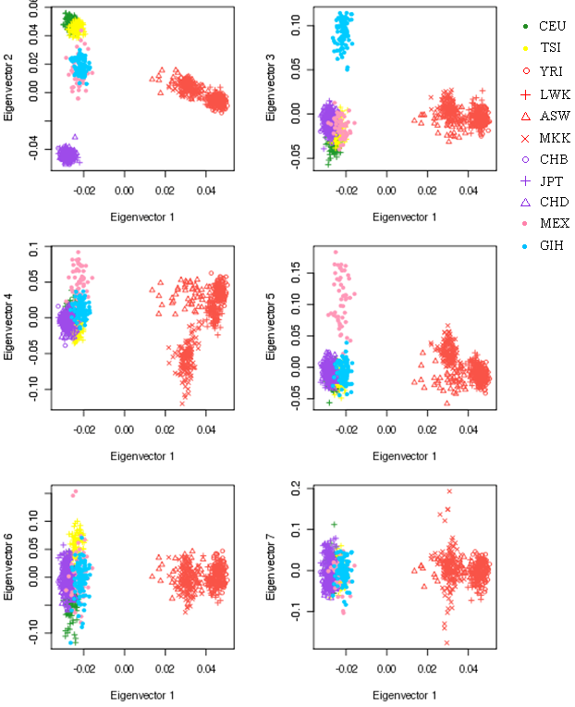
HapMap3 Sample – Principal components
Cavalli-Sforza et al. 1994
Price et al. Nat Gen 2006
Novembre et al. Nat 2008

Slide 74
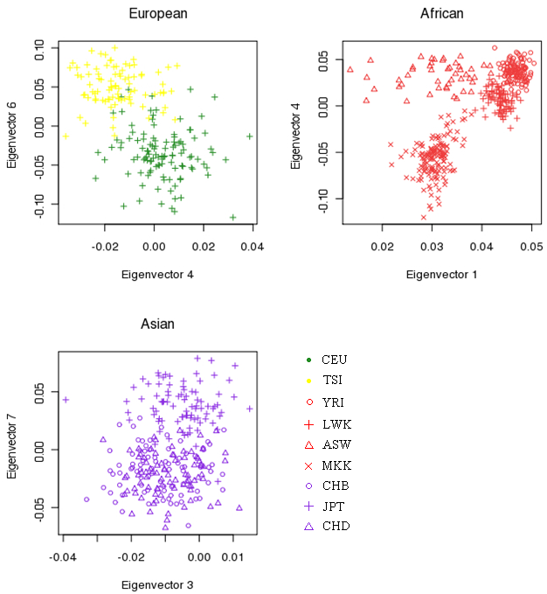
Resolution of the Relatedness

Slide 75
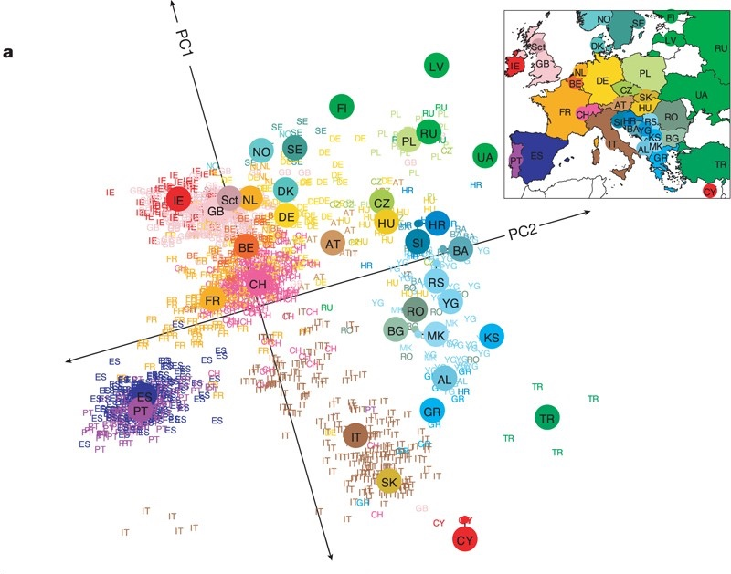
Genes mirror geography within Europe
Novembre, John, et al. Nature 2008

Slide 76
Continuum of Diversity (using Genetic Ancestry/clustering)
Tishkoff et al. (2009). The Genetic Structure and History of Africans and African Americans. Science 324, 1035-1044.

Slide 77
Children’s Health Study: Individual Admixture
Estimate Ancestries:
European
Native American
East Asian
African
Populations | STRUCTURE Plots (based on AIM233)
 | Non-Hispanic Hispanic Hispanic Hispanic White White Other Mix
CHS by itself
CHS+MEC
CHS+HapMap
Study
Population
Reference Population
Notes:
Change the figure (1) remove the yellow part (2) reorder

Slide 78
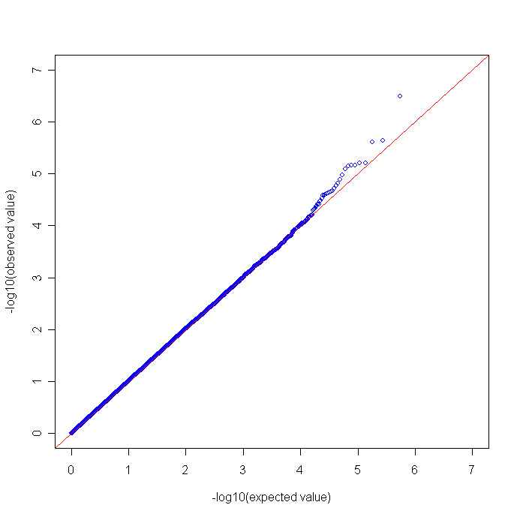
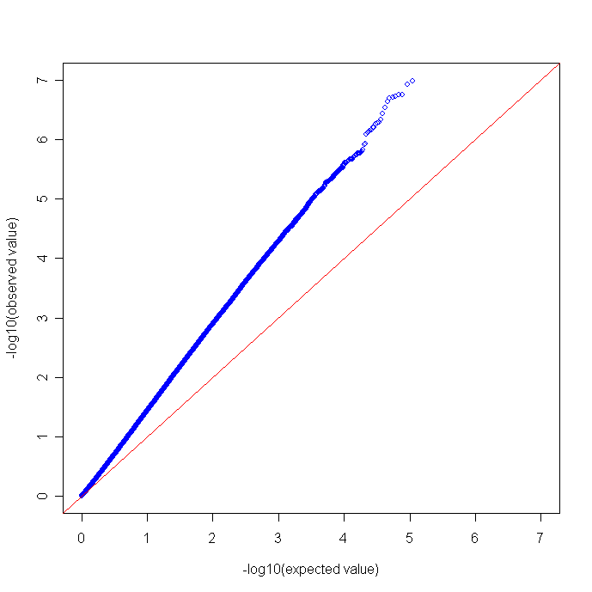
Q-Q Plot: By Self-Identified Ethnicity
Non-Hispanic: N=1,162
Hispanic: N=1,013
λ = 1.01
λ = 1.62

Slide 79

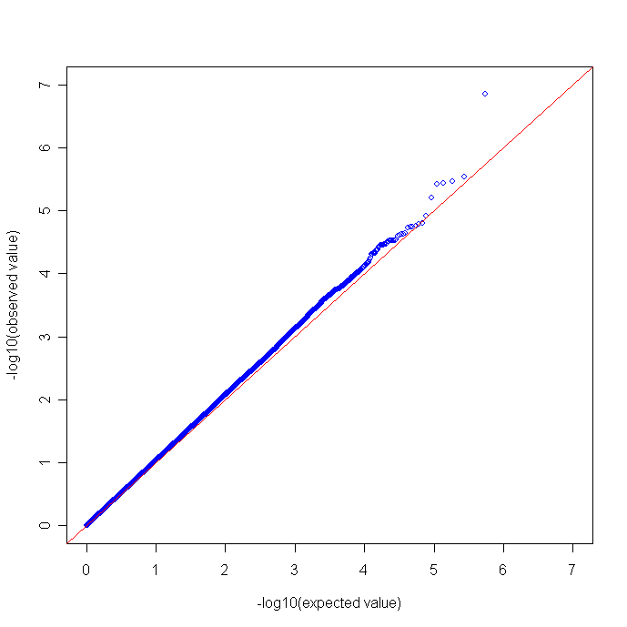
Q-Q Plot: Adjusted
Non-Hispanic: N=1,162
Hispanic: N=1,013
λ = 1.02
λ = 1.05

Slide 80
Principal Components Analysis

Slide 81
Polygenic Risk Scores

Slide 82
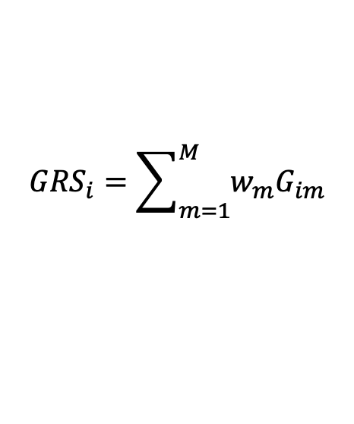
Polygenic (Genetic) Risk Prediction
Genetic Risk Score (GRS):
Weighted sum of # risk alleles carried by each participant
Count of risk alleles for
variant m for individual i
What SNPs?
$${GRS}_{i}=\sum_{m=1}^{M}{w_{m}G_{im}}$$
What weight?
0-10%
25-75%
90-100%
How to evaluate?
GRS

Slide 83
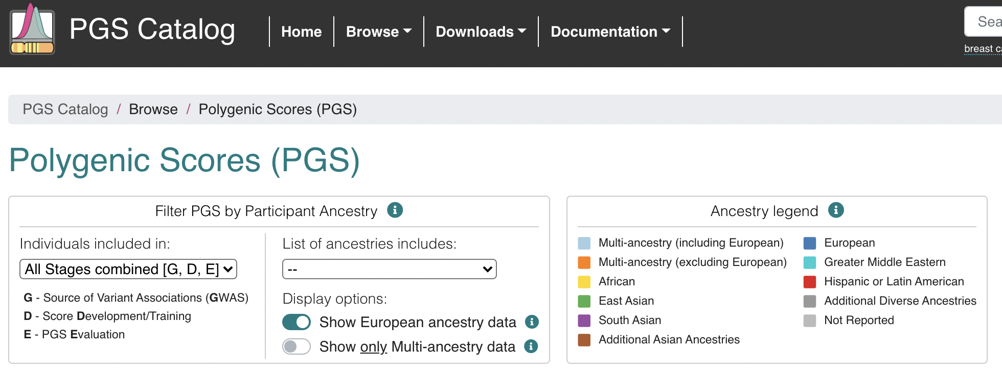
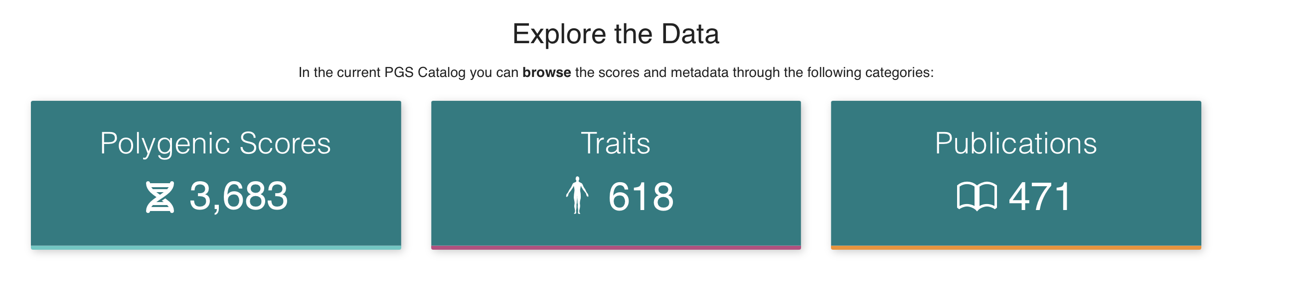
PRS Catalog
www.pgscatalog.org

Slide 84
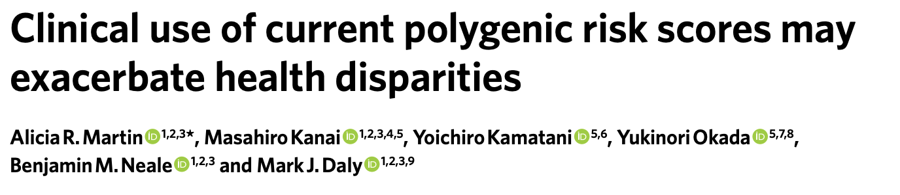
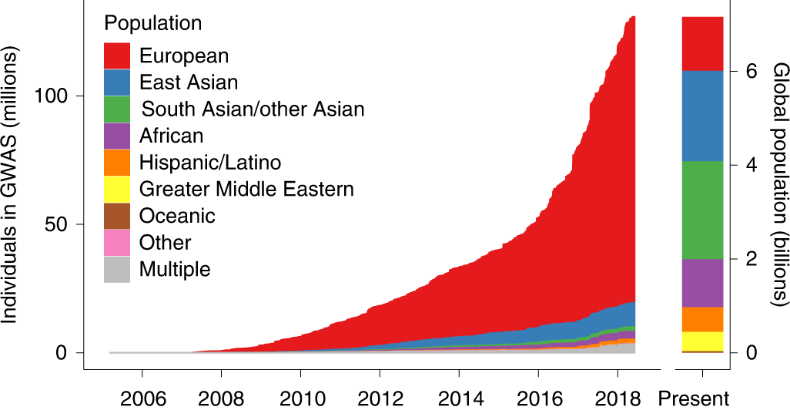
Caveats of SNP-based prediction

Slide 85
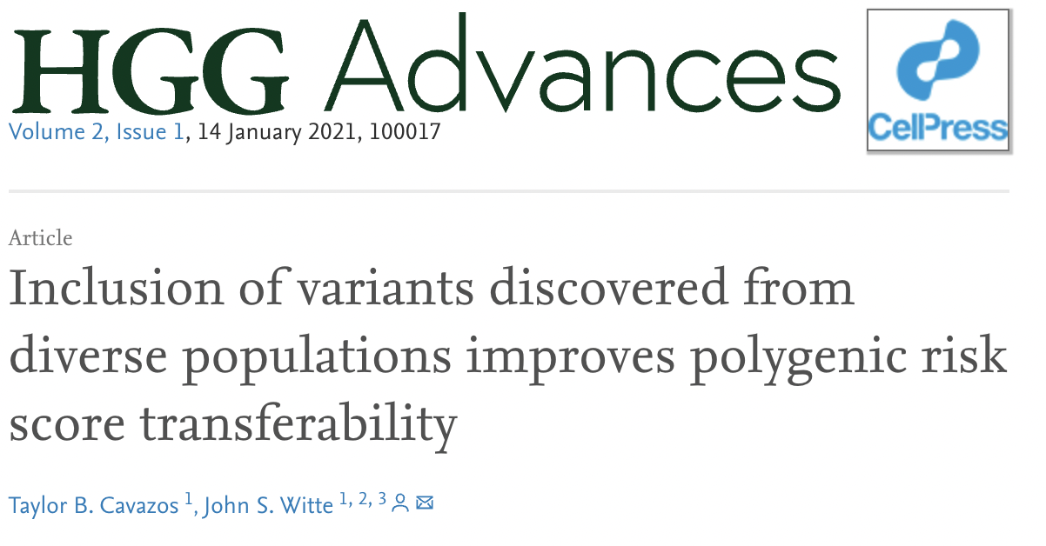

Diverse GWAS cohorts improves PRS portability

Slide 86

GRS Within Population Comparisons
Notes:
Asian-specific GWAS from Riken et al. in preparation/prep…
Latino GWAS is in preparation.

Slide 87
Genetic Risk Score (GRS) for Prostate Cancer, 269 variants
4
Genetic Risk Score Analysis
Population | Cases | Controls
African | 9,126 | 8,702
Asian | 1,652 | 1,803
European | 71,570 | 52,531
Latino | 2,226 | 2,098
2.5
Conti et al Nat Genet 2021
Notes:
We included all participants that we have individual level data on from the GWAS in our PRS analyses, as shown in this table. Our primary results are shown in this figure. Looking at the top PRS decile, men of EUR ancestry have the highest odds of PCa (5.1) followed closely by Asian and Hispanic men, with African ancestry men having the lowest odds (3.7). We replicated these findings in an independent sample of ~2600 AFR ancestry men (from CA UG study) and ~200K EUR ancestry men from the UK Biobank. And we saw very similar odds ratios, a little lower in EUR but nearly identical in AFR

Slide 88
GRS in 1000 Genomes Populations
Notes:
Asian-specific GWAS from Riken et al. in preparation/prep…
Latino GWAS is in preparation.

Slide 89
Absolute Risks of Prostate Cancer
by Age and PRS
European
0.38
0.38
0.31
0.26
Ancestry-Specific Risk Estimates (PRACTICAL - GWAS)
Ethnic-Specific Incidence Rates (SEER)
Ethnic-Specific Mortality Rates (SEER)
Antoniou, A. C. et al. Cancer Res. (2010).
Antoniou, A. C. et al. Gen. Epi (2001).
Kuchenbaecker, et al. JNCI (2017).

Slide 90
Thanks!
dconti@usc.edu

